Slide 1
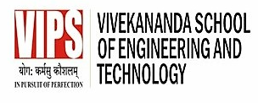

Practicum Presentation Topic: “White-Board Hand Gesture Recognition System”
Raunak Negi- 07017711622 (AIML-A)
Ayush Chauhan- 09017711622 (AIML-B)
Tanishq Rawat- 11217711622 (AIML-B)
Supervisor:
Dr. Ashish Kumar

Slide 2
Index of Contents
Introduction & Motivation
Problem Statement
Background Study
Technology Stack
Project Progress/Implementation(screenshots/video etc.)
Aim for the coming weeks
References

Slide 3
1. Introduction & Motivation
Hand gesture recognition systems are integral components of human-computer interaction, enabling users to convey commands or inputs through natural movements. These systems utilize computer vision and machine learning techniques to interpret gestures made by the hand and translate them into actionable commands. The evolution of gesture recognition technology has seen significant advancements, driven by the growing demand for intuitive interfaces in various domains, including gaming, virtual reality, robotics, and smart environments. By harnessing the power of cameras and sophisticated algorithms, these systems can accurately detect, track, and classify hand gestures in real-time, providing users with seamless and immersive interaction experiences.
One of the key challenges in hand gesture recognition lies in robustly identifying and distinguishing between different gestures amidst variations in lighting conditions, background clutter, and hand orientations.

Slide 4
1. Introduction & Motivation
Researchers and developers have addressed these challenges through the development of deep learning models, such as Convolutional Neural Networks (CNNs) and Recurrent Neural Networks (RNNs), which excel at extracting meaningful features from visual data and learning complex temporal patterns.
As these technologies continue to mature, hand gesture recognition systems hold immense potential for revolutionizing human-computer interaction, paving the way for more natural and intuitive interfaces that enhance user experience and productivity across various applications and industries.

Slide 5
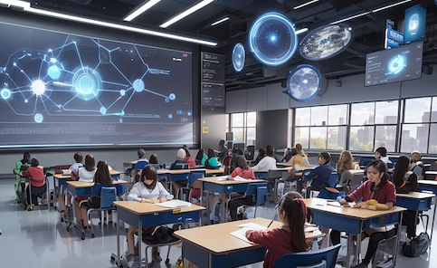
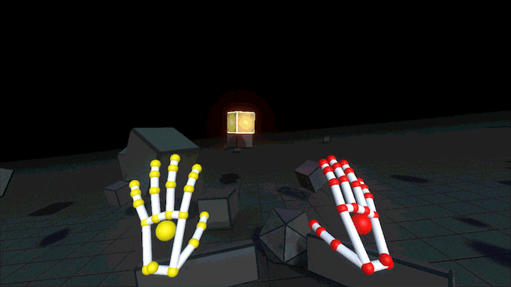
2. Problem Statement
Education: Interactive whiteboards allow natural writing and drawing with hand gestures, facilitating dynamic teaching and student engagement while promoting inclusivity for all learners.
Gaming: Hand gestures offer an intuitive and immersive gaming experience, enabling players to control characters and interact with virtual environments effortlessly, particularly benefiting those with controller limitations.

Slide 6
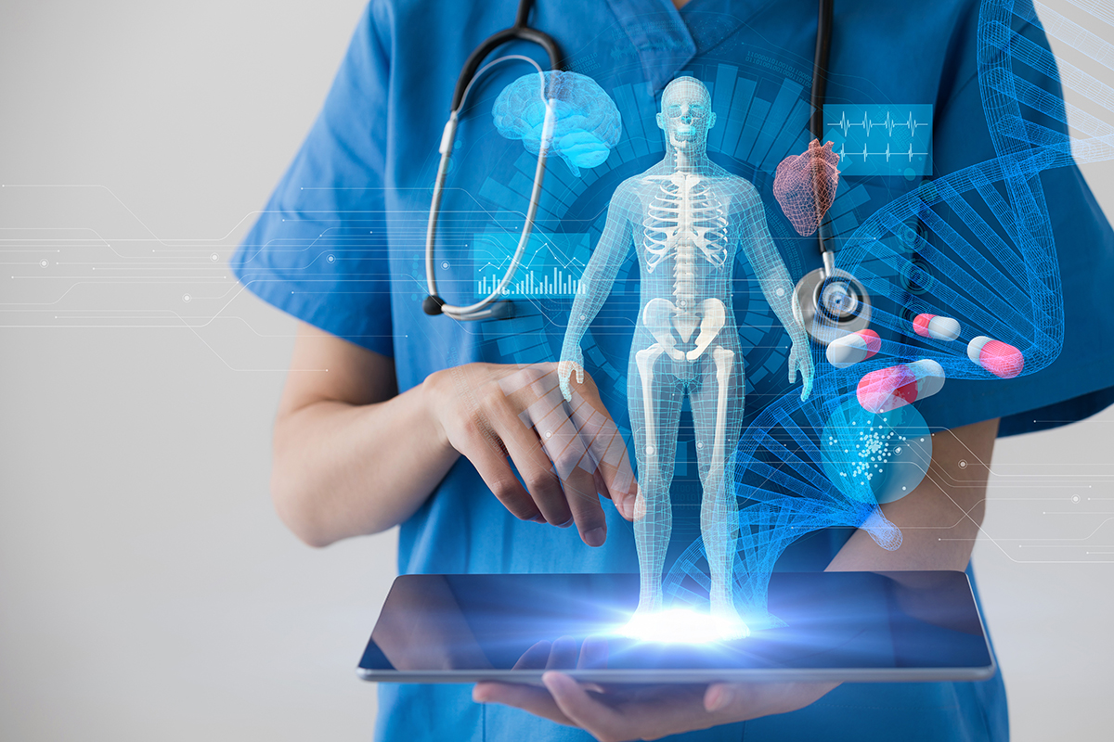
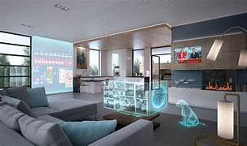
2. Problem Statement
Medicine: Surgeons can utilize gesture-controlled interfaces for hands-free operation control, minimizing contamination risks and enhancing precision during procedures, leading to improved efficiency in the operating room.
Smart Homes: Hand gestures provide a hands-free control interface for smart home devices, offering convenience and hygiene benefits, especially in environments like kitchens.

Slide 7
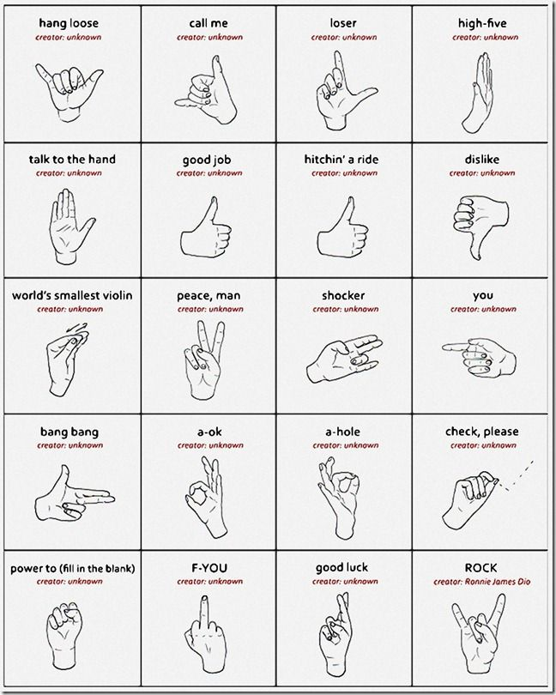
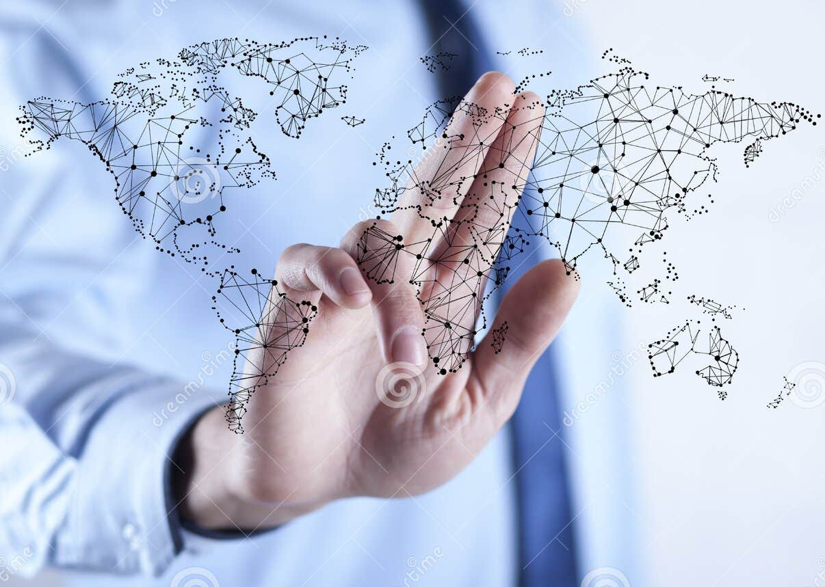
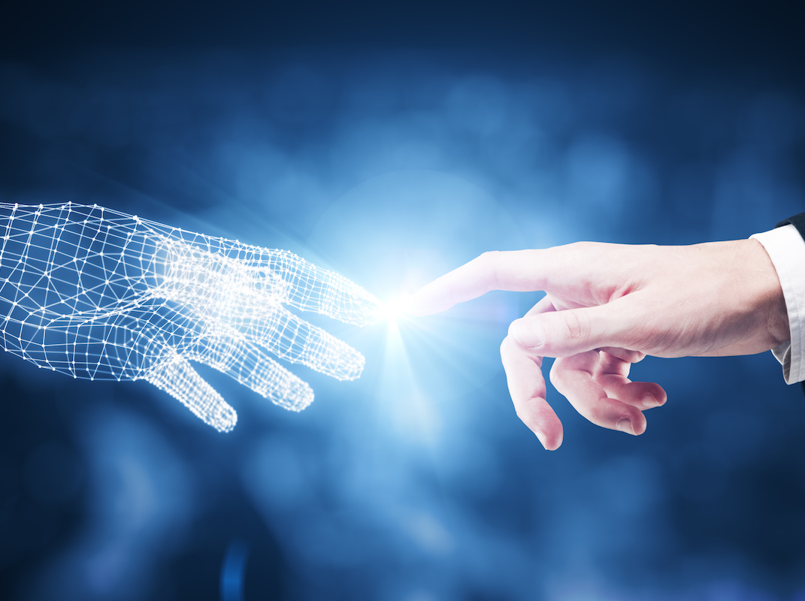
2. Problem Statement
Communication: Gesture recognition aids in sign language translation, bridging the gap between deaf and hearing individuals, promoting social inclusion and accessibility.

Slide 8
3. Background Study
[1] By N Mohamed, MB Mustafa, N Jomhari - IEEE Access :-
This paper reviewed the sign language research in the vision-based hand gesture recognition system from 2014 to 2020. The review shows that the vision-based hand gesture recognition research is an active field of research, with many studies conducted, resulting in dozens of articles published annually in journals and conference proceedings.
[2] By P Parvathy, K Subramaniam - Journal of Ambient: -
Human computer interaction (HCI) systems are increasing due to the demand for non-intrusive methods for communicating with machines. In this research article, vision-based hand gesture recognition (HGR) System has been proposed using machine learning. This proposed system consists of three stages: segmentation, feature extraction and classification.
[3] By TH Tsai, CC Huang, KL Zhang - Multimedia tools and applications: -
Hand gestures are one of the most intuitive and common forms of communication, and can communicate a wide range of meaning. Vision-based hand gesture recognition has received a significant amount of research attention in recent years. However, the field still presents a number of challenges for researchers.
[4] By F Al Farid, N Hashim, J Abdullah, MR Bhuiyan - journal of imaging :-
This paper aims to uncover the limitations faced in image acquisition through the use of cameras, image segmentation and tracking, feature extraction, and gesture classification stages of vision-driven hand gesture recognition in various camera orientations. This paper looked at research on vision-based hand gesture recognition systems from 2012 to 2022.

Slide 9
3. Background Study
[5] By M Oudah, A Al-Naji, J Chahl - journal of Imaging :-
This paper focuses on a review of the literature on hand gesture techniques and introduces their merits and limitations under different circumstances. In addition, it tabulates the performance of these methods, focusing on computer vision techniques that deal with the similarity and difference points, technique of hand segmentation used, classification algorithms and drawbacks, number and types of gestures, dataset used, detection range (distance) and type of camera used. This paper is a thorough general overview of hand gesture methods with a brief discussion of some possible applications.
[6] By H Su, SE Ovur, X Zhou, W Qi, G Ferrigno… - Advanced …, 2020
The development of advanced techniques in data science, such as big data and machine learning, facilitate the accurate classification of the hand gestures using electromyography (EMG) signals. However, the processing of the collection and label of the large data set imposes a high work burden and results in time-consuming implementations. It can label the class of the collected EMG data under the guidance of depth vision automatically, without consideration of the hand motion sequence.
[7] By YS Tan, KM Lim, CP Lee - Expert Systems with Applications, 2021
Hand gesture recognition (HGR) serves as a fundamental way of communication and interaction for human being. HGR can be applied in human computer interaction (HCI) to facilitate user interaction, it can also be utilized for bridging the language barrier. HGR can be utilized to recognize sign language, which is a visual language represented by hand gestures and used by the deaf and mute all over the world as a primary way of communication. The effectiveness of the system and its ability to deal with varied challenges across multiple datasets are heavily reliant on the methods being utilized.

Slide 10
3. Background Study
[8] By W Zhang, J Wang, F Lan - IEEE/CAA Journal of Automatica …, 2020
Hand gestures are a natural way for human-robot interaction. This paper presents a novel deep learning network for hand gesture recognition. The network integrates several well-proved modules together to learn both short-term and long-term features from video inputs and meanwhile avoid intensive computation. Each video input is segmented into a fixed number of frame groups. A frame is randomly selected from each group and represented as an RGB image as well as an optical flow snapshot. These two entities are fused and fed into a convolutional neural network (ConvNet) for feature extraction.
[9] By F Pezzuoli, D Corona, ML Corradini - SN Computer Science, 2021
A sign language translation system based on a wearable device represents indeed a more efficient solution with respect to cameras or position trackers for helping speech-impaired people daily. The paper describes the different steps required for a sign language translation, namely segmentation, feature extraction and classification, together with the custom data-glove used for data-acquisition. The paper presents also experimental results, comparing different machine learning classifiers and discussing their performances both in terms of translation accuracy and computational time.
[10] By R Ferhat, FZ Chelali - Multimedia Tools and Applications, 2024
Hand gesture recognition has become one of the most important directions in human-computer interaction (HCI) research. In this paper, a hand gesture and sign recognition system (HGRS/SGRS) based on textural features is implemented using a local binary pattern (LBP), local directional pattern (LDP), local optimal-oriented pattern (LOOP) and local Gabor binary pattern histogram sequence (LGBPHS).

Slide 11




4. Technology Stack
Development Tools
Jupyter Notebook or Jupyter Lab
IDEs (VS Code, Pycharm)
HTML/CSS/JavaScript
GitHub
Modules/Libraries
Mediapipe
PyautoGUI
OpenCV

Slide 12
5. Project Progress/Implementation
Algorithm: Hand Gesture Recognition
1. Import necessary libraries: time, cv2 for OpenCV, mediapipe for hand detection, and pyautogui for controlling the mouse cursor.
2. Set up the video capture from the default camera (0).
3. Initialize the hand detector from MediaPipe with specified confidence thresholds for detection and tracking.
4. Define variables for mouse control: index_y to track the y-coordinate of the index finger, flags for left and right click activation (click_active and right_click_active), thresholds for click detection (click_threshold and right_click_threshold), durations for maintaining click (click_duration and right_click_duration), and timestamps for last click (last_click_time and right_last_click_time).
5. Enter a continuous loop for capturing video frames and processing hand gestures.
6. Read a frame from the video capture, flip it horizontally for a mirror effect, and convert it to RGB format (required by MediaPipe).
7. Process the frame with the hand detector to detect hand landmarks.
8. If hands are detected, iterate through each hand and extract landmark coordinates for the index finger, thumb, and middle finger.
9. Calculate the screen coordinates based on the hand landmarks and the screen resolution.
10. Move the mouse cursor to the calculated screen coordinates using pyautogui.moveTo().

Slide 13
5. Project Progress/Implementation
Algorithm: Hand Gesture Recognition
11. Check for conditions to activate left-click and right-click actions based on the distance between the index finger and thumb (click_threshold and right_click_threshold).
12. If the conditions are met, simulate mouse button press (pyautogui.mouseDown()) and track the duration of the click.
13. If the click duration exceeds the specified threshold, release the mouse button (pyautogui.mouseUp()).
14. Repeat the process for right-click actions.
15. If no hands are detected, ensure that any active mouse buttons are released.
16. Display the processed frame with hand landmarks and mouse cursor movement.
17. Exit the loop if the 'q' key is pressed.
18. Release the video capture and close all OpenCV windows.

Slide 14
5. Project Progress/Implementation
Algorithm: White-Board
1. Import the Tkinter library as tk.
2. Define a class named Whiteboard.
3. In the constructor (__init__), initialize the root window, canvas for drawing, color palette, pen and eraser buttons, thickness slider, and clear all button.
4. Bind mouse events to respective methods for drawing, erasing, and zooming.
5. Define methods for setting pen and eraser modes, setting draw color, thickness, drawing, erasing, and clearing canvas, and zooming.
6. Implement methods to handle drawing and erasing actions using the canvas.create_line() and canvas.create_rectangle() methods.
7. Implement a method to handle zooming using the canvas.scale() method.
8. Instantiate the Whiteboard class within a Tkinter root window and start the main event loop with root.mainloop().

Slide 15
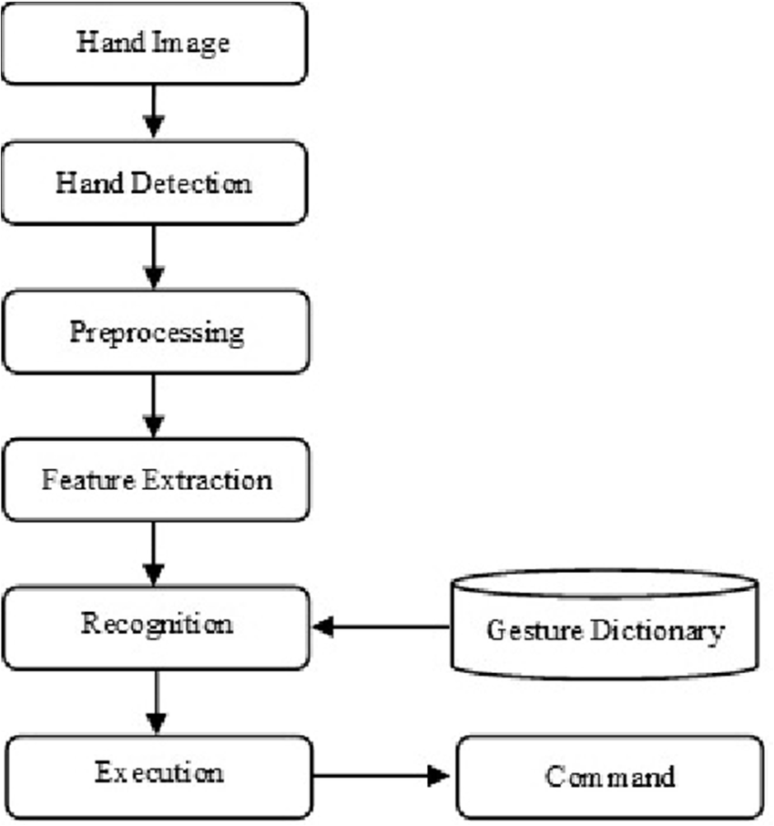
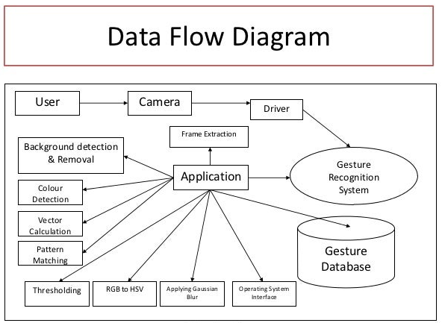
5. Project Progress/Implementation

Slide 16
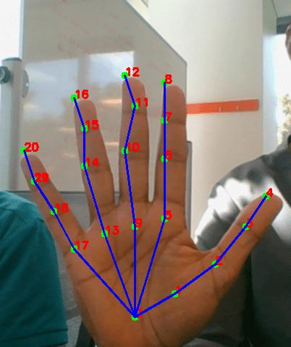
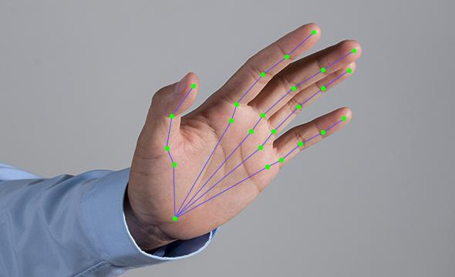
5. Project Progress/Implementation

Slide 17
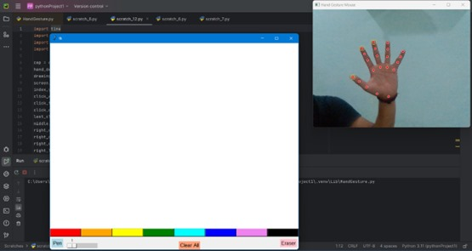
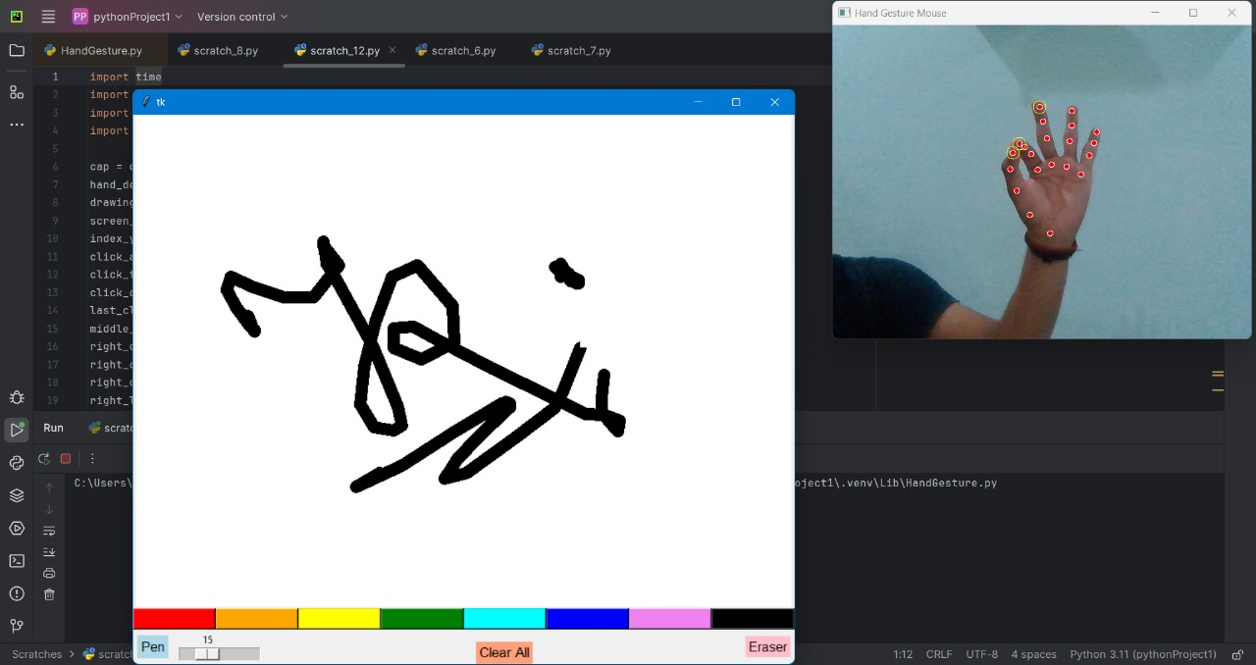
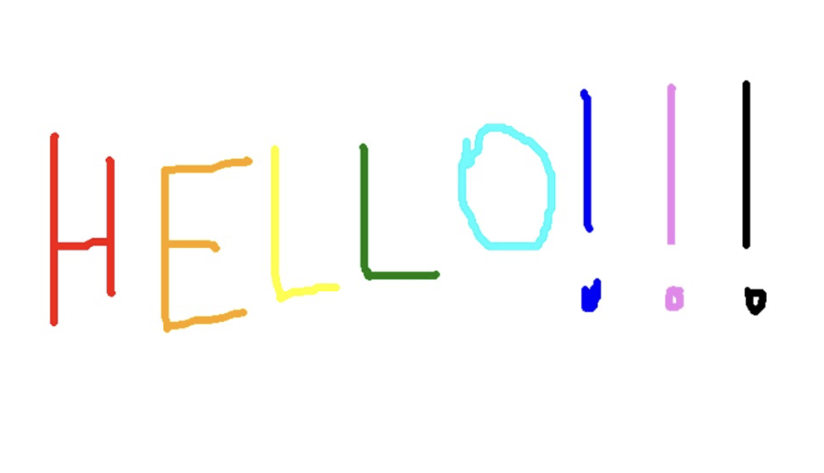
5. Project Progress/Implementation

Slide 18
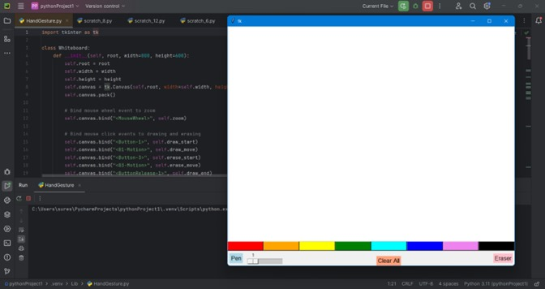
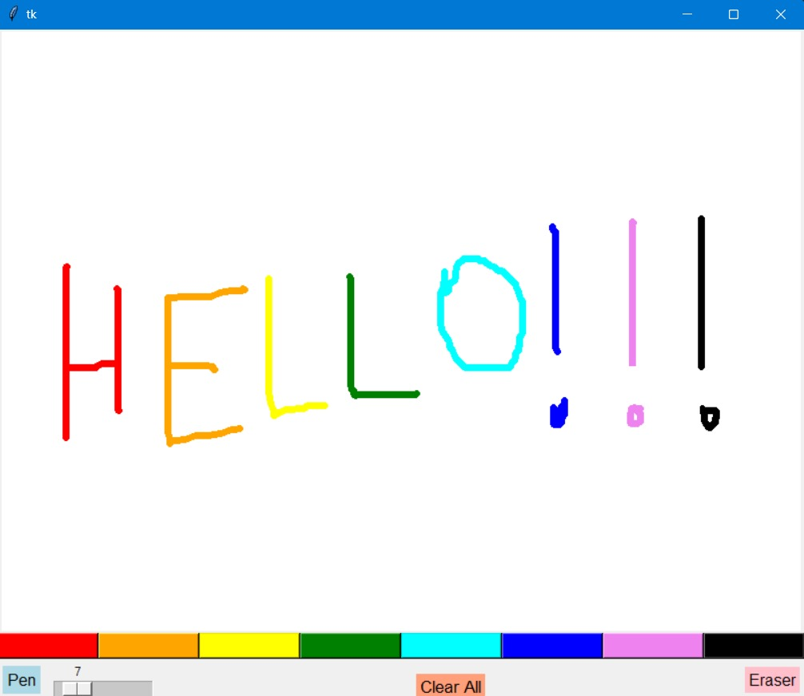
5. Project Progress/Implementation

Slide 19
6. What more can be Done!
Including generative AI: By implementing generative AI to this project we can get the information and relatable images of what user has drawn on the screen.
Including Grid Lines: By giving grid lines to the screen it is possible to write a whole paragraph in the air.

Slide 20
7. References
Mohamed, Noraini, Mumtaz Begum Mustafa, and Nazean Jomhari. "A review of the hand gesture recognition system: Current progress and future directions." IEEE Access 9 (2021): 157422-157436.
Parvathy, Priyanka, et al. "Development of hand gesture recognition system using machine learning." Journal of Ambient Intelligence and Humanized Computing 12 (2021): 6793-6800.
Tsai, Tsung-Han, Chih-Chi Huang, and Kung-Long Zhang. "Design of hand gesture recognition system for human-computer interaction." Multimedia tools and applications 79 (2020): 5989-6007.
Al Farid, Fahmid, et al. "A structured and methodological review on vision-based hand gesture recognition system." Journal of Imaging 8.6 (2022): 153.
Oudah, Munir, Ali Al-Naji, and Javaan Chahl. "Hand gesture recognition based on computer vision: a review of techniques." journal of Imaging 6.8 (2020): 73.
Su, Hang, et al. "Depth vision guided hand gesture recognition using electromyographic signals." Advanced Robotics 34.15 (2020): 985-997.

Slide 21
7. References
7. Tan, Yong Soon, Kian Ming Lim, and Chin Poo Lee. "Hand gesture recognition via enhanced densely connected convolutional neural network." Expert Systems with Applications 175 (2021): 114797.
8. Zhang, Wenjin, Jiacun Wang, and Fangping Lan. "Dynamic hand gesture recognition based on short-term sampling neural networks." IEEE/CAA Journal of Automatica Sinica 8.1 (2020): 110-120.
9. Pezzuoli, Francesco, Dario Corona, and Maria Letizia Corradini. "Recognition and classification of dynamic hand gestures by a wearable data-glove." SN Computer Science 2 (2021): 1-9.
10. Ferhat, Roumiassa, and Fatma Zohra Chelali. "Textural feature descriptors for a static and dynamic hand gesture recognition system." Multimedia Tools and Applications 83.3 (2024): 8165-8187.

